Slide 1

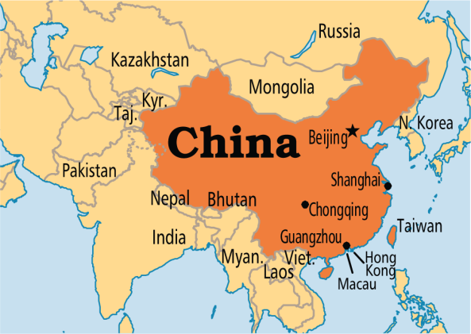

Internationalizing Date (I18N with Date)
The format of the dates differ from one region to another that is why we internationalize the dates.
We can internationalize the date by using the getDateInstance() method of the DateFormat class. It receives the locale object as a parameter and returns the instance of the DateFormat class.
Language = English
Feb 19, 2018
Language = Chinese
2018-2-19
Language = French
19 févr. 2018

Slide 2
TimerTask
https://docs.oracle.com/javase/8/docs/api/index.html?java/util/ListResourceBundle.html

